Slide 1


Am I responsive? Test me!
Galen framework

Slide 2


About me
Fernando Martín
Senior QA Engineer
Tech lover
Quasi-blogger
http://bit.ly/fer-mg

Slide 3

What am I showing today?

Slide 4

Responsive Web Design
Notes:
Different screen size and element appearance for devices
Google is penalizing websites that aren’t responsive.
Statista : 2017 - 50,3% web pages served to mobile phones

Slide 5

Layout testing

Slide 6


What’s Galen?
Human readable
Syntax
Basic
Advanced
Reports
JS and Java APIs
Selenium integration

Slide 7
Installation
Download
http://galenframework.com/download/
Last release: 2.3.6
Extract
Install
Linux/OS X: sudo ./install.sh
Windows: galen.bat

Slide 8

Galen Spec Language
Object definition
Galen spec language
@objects search-panel id search-bar search-panel-button css #search-bar a menu-item-* css #menu li a
HTML
<body> <div id='search-bar'> <input type='text' name='search' value=''/> <a href='#' class='search-button'>Search</a> </div> <ul id='menu'> <li><a href='#'>Home</a></li> <li><a href='#'>Blog</a></li> </ul> </body>

Slide 9
Galen Spec Language
Object specs
near
below
above
left-of, right-of
inside
width
height
aligned
text
visible
centered
absent
contains
on
component
Frame support
count
color-scheme
Image

Slide 10
Galen Spec Language
Advanced object specs
Importing
Same spec to multiple objects
If statements
Loops
Warning level
Custom rules
“Exceptions”
Galen Spec JS API

Slide 11
Galen Spec Language
Ranges
width 100px
width 50 to 200 px
width 30 to 100 % of screen/width
Variables
@set headerMargin 10 to 20px = Header = header-icon: inside header ${headerMargin} top left

Slide 12
Galen Spec Language
Tagging and sections
= Main section = @on * menu: height 300 px @on desktop login-button: height 40 px

Slide 13
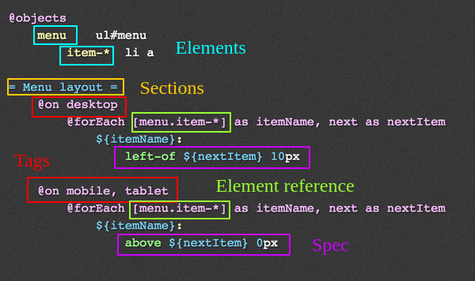
Galen Spec Language

Slide 14
Running tests
Single page test
args: url | javascript | include/exclude | size | htmlreport | testngreport | jsonreport
$ galen check specFilePath [args]
$ galen check homepage.spec --url “http://example.com” --size “640x480” --include “mobile” --htmlreport “myDir”

Slide 15
Running tests
Test suite
args: htmlreport | testngreport | parallel-tests | recursive | filter
$ galen test testSuitePath [args]
$ galen test mytest01.test --testngreport "report/testng.xml" --parallel-tests 2

Slide 16
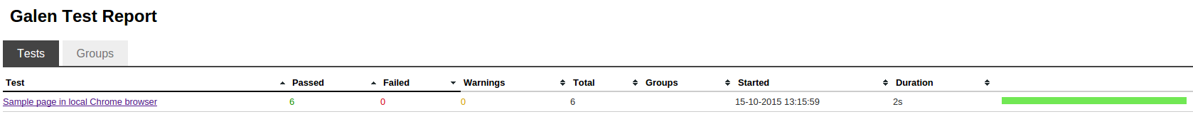
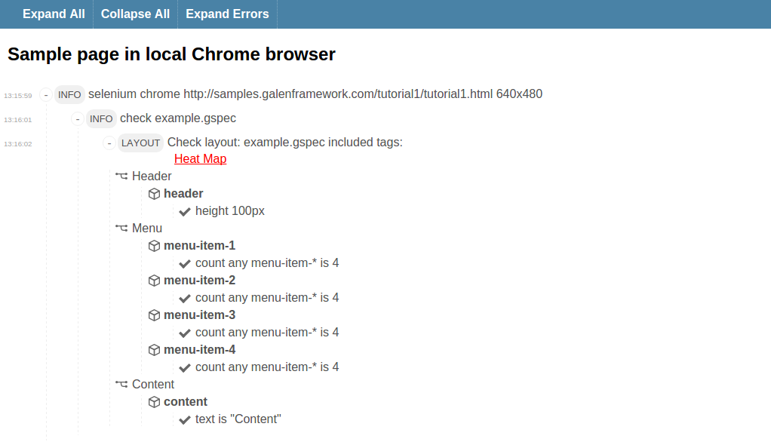
Reports

Slide 17
Resources
Official website: http://galenframework.com/
Github: https://github.com/galenframework
More examples: http://mindengine.net/category/galen/

Slide 18

Demo time!

Slide 19




Thank you!
Questions?
Fernando Martín
efemgy@gmail.com
fer3MG
https://github.com/fernando-martin
http://bit.ly/aftertest-bcn

